Slide 1

" Educate, Empower, Engage"
360 degree multi touch Patient Education Campaign Ideations

Slide 2

Why Choose Us?
As the Irish legend goes, finding a four leaf clover is rare and for every 10,000 three leaf clovers, there is only ONE four leaf clover
We are the ‘four leaf clover’ in the media ideas business
Finding us is great news for your marketing efforts since we come with experience across media and are tuned to find exciting, break through ideas that deliver

Slide 3
The IDEA
To cover doctors Across the country
To provide multi touch points
To increase scope of engagement with the Doctor
To Communicate the core proposition of the Brand

Slide 4
Multi Touch Point Patient Education Platforms
Content creation
Publishing
Television: All India regional channels
Print : All India Print integration M
Radio: Nationwide coverage
Web: Targeting Local 18 channels
Cinema Advertising
On-Ground Events: Walkathons / World Records / Yoga Day / CPR Day
Social Media: YouTube, Instagram, Facebook
Podcasts : Dedicated Podcast channel creations
Personalized Greetings: Doctors record personalized video messages for patients, shared across social media
In Clinic Customized Activities

Slide 5
Strength in Video Production & Editing
Shoots across 100+ cities with verified local crews
Expertise in doctor interviews, clinic walk-throughs & testimonials
12+ language capability – shoot & post-production
Cinema, TV, and digital ad-ready outputs
AI-powered VO, subtitles & cutdowns
Compliant with medical and legal guidelines
Fully in-house scripting to final delivery

Slide 6
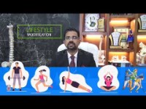
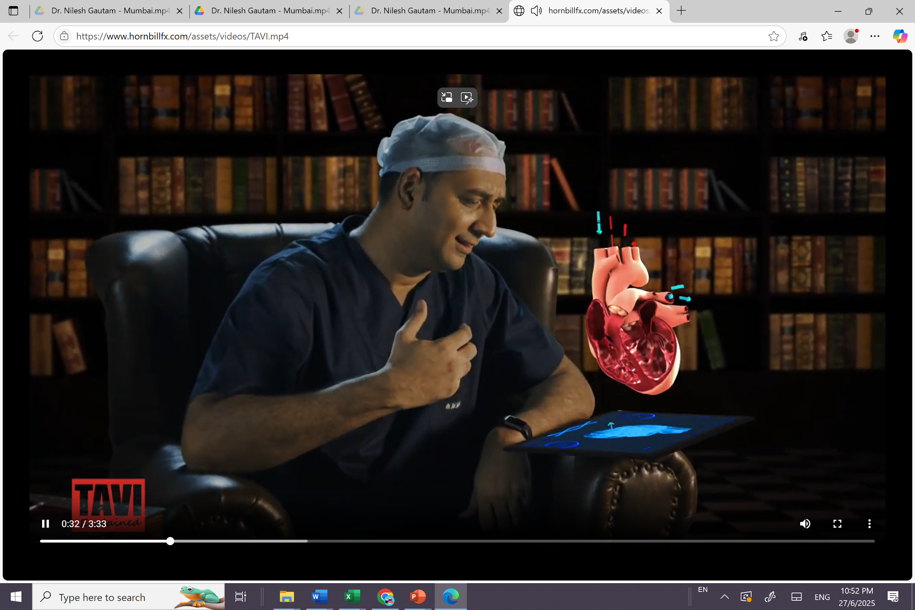
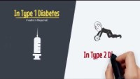
Video Content Solutions
hornbillfx.com/assets/videos/TAVI.mp4
Whiteboard Animation
Graphics Integration
3D Animation
Engaging educational content with clear visual storytelling for complex medical concepts and patient education.
Professional video production combining live action with sophisticated graphic elements and motion design.
Advanced three-dimensional animations bringing medical procedures and anatomical concepts to life with precision.

Slide 7
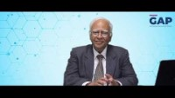
Video Content Solutions
We produce medicolegal videos that simplify complex legal issues for doctors. From consent explainer videos to case law breakdowns and medico-ethical scenarios. Backed by legal experts, shot with clarity and compliance. Trusted by hospitals and associations for doctor education and risk awareness.

Slide 8
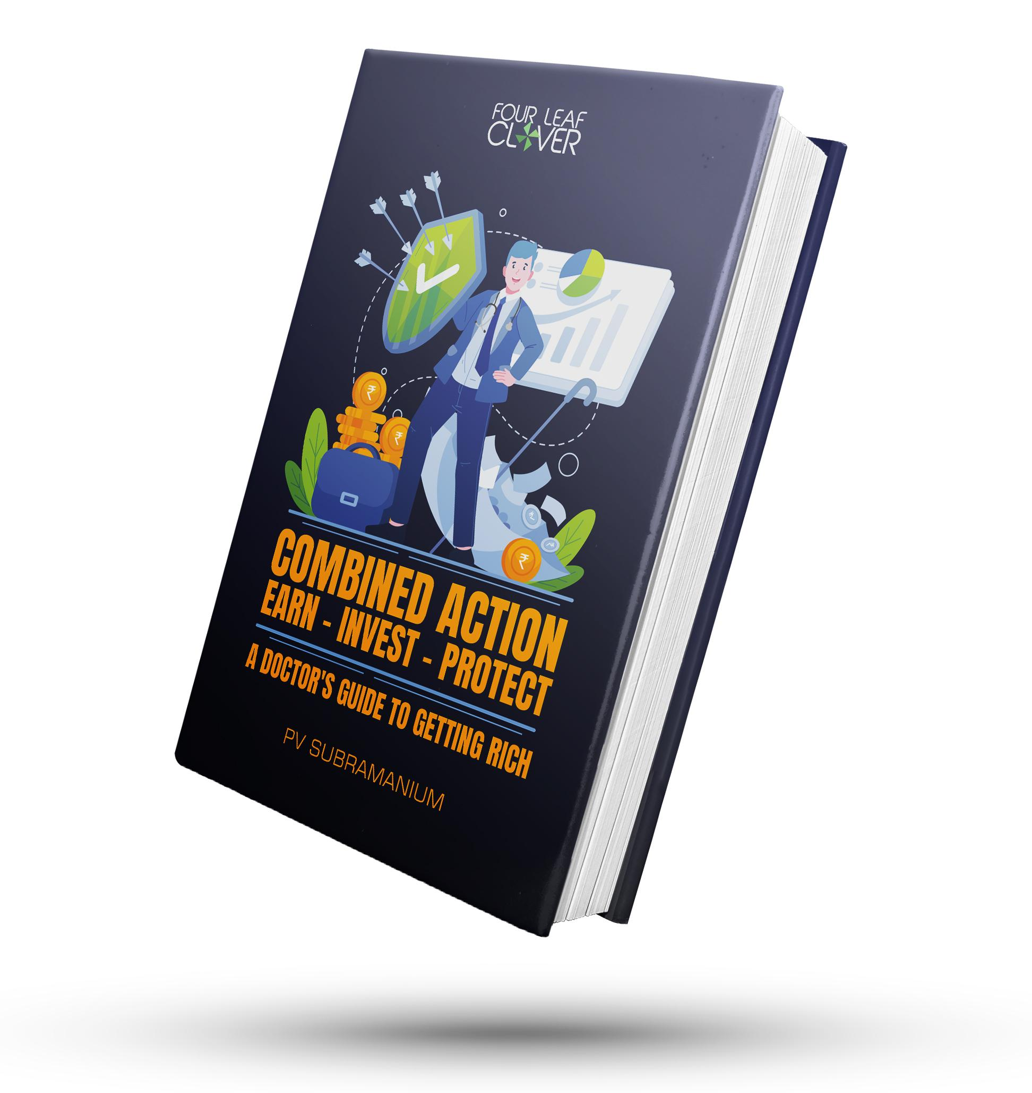

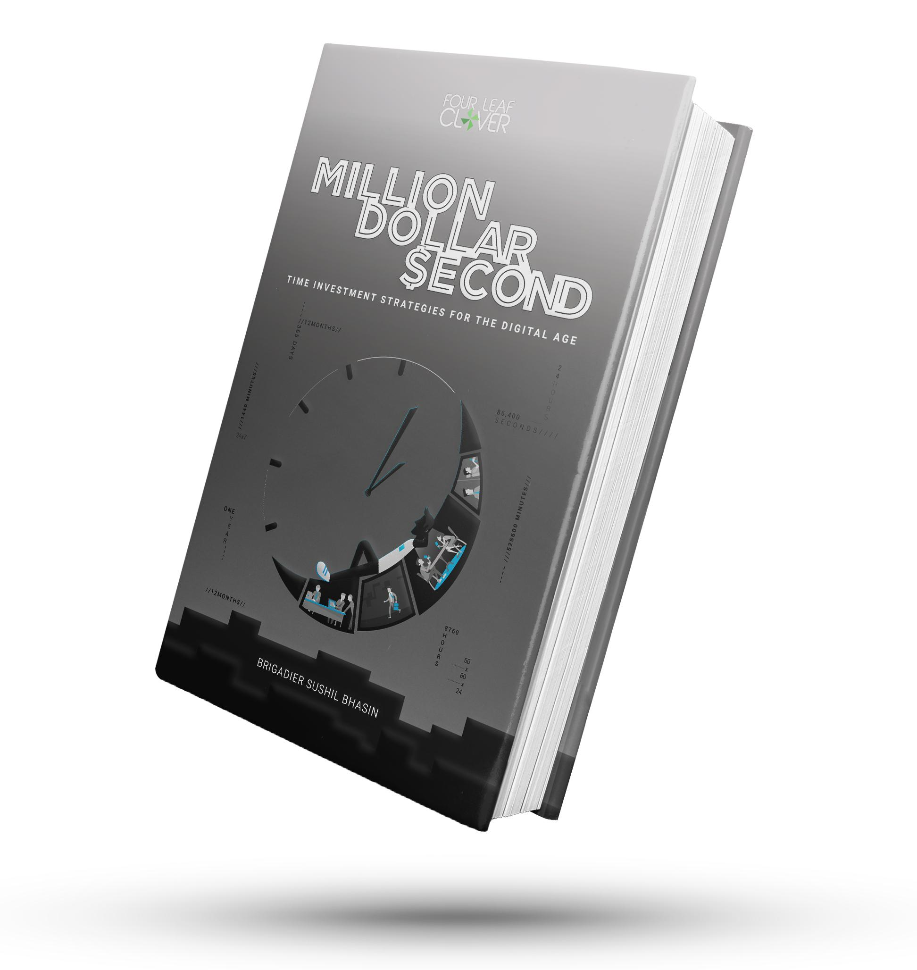


Publishing Portfolio
Finance Focus
Business Growth
Legal Compliance
Succession planning strategies
Social media marketing
Patient consent protocols
Clinic management systems
Technology integration
Supreme Court guidelines
Tax optimization guides
Clinic setup guidance
Consumer law compliance
Investment planning resources
Practice management
Risk management

Slide 9
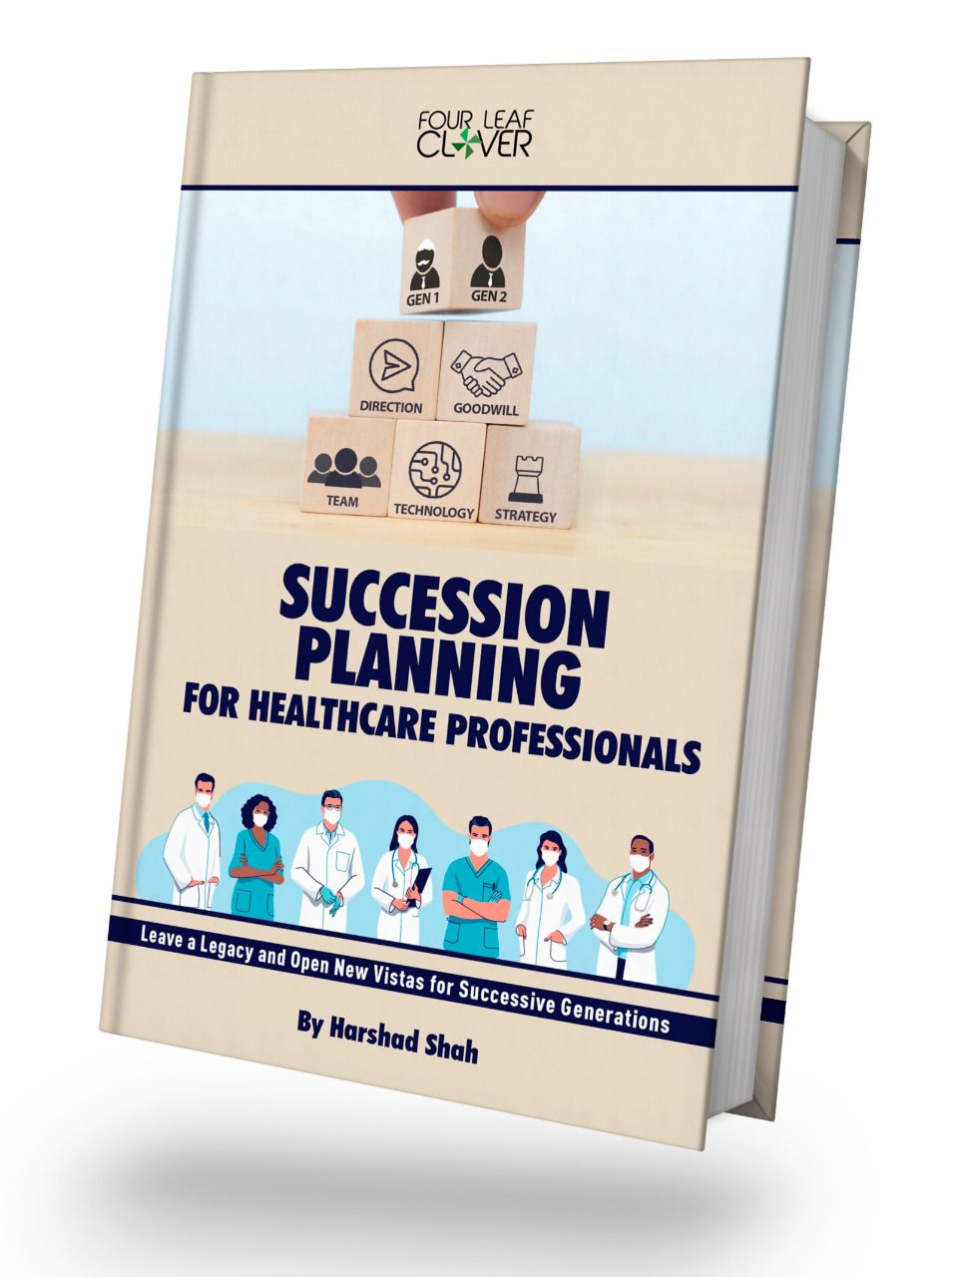
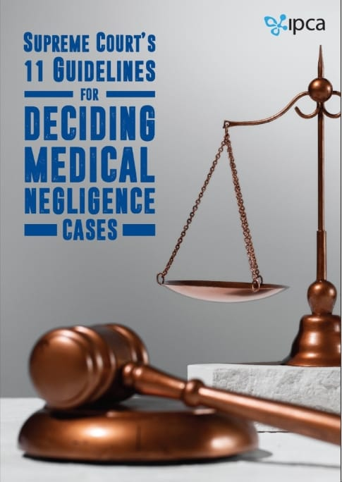
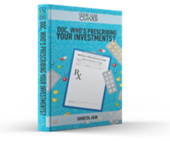
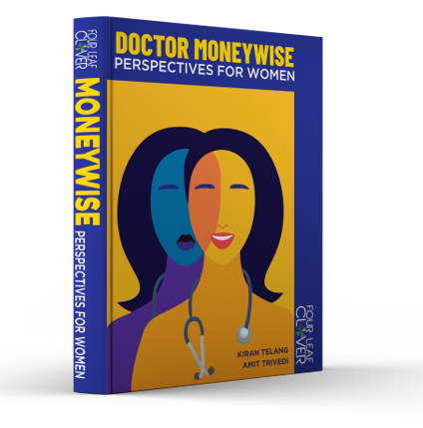

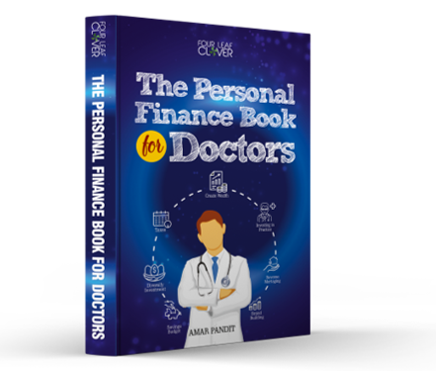

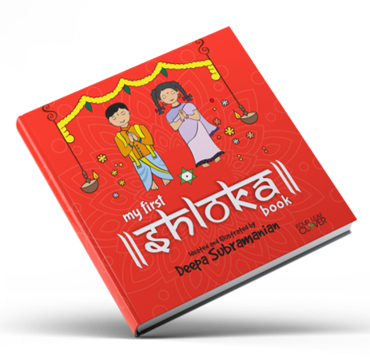

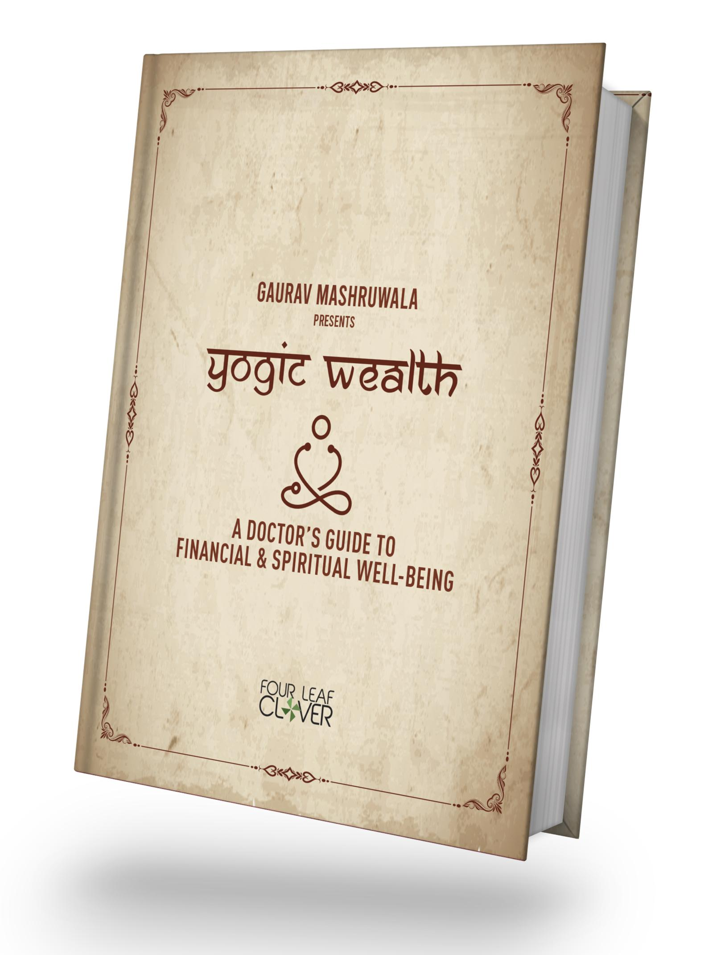

Slide 10
WEB – Local 18
News18 Local
https://www.news18.com/news18local/
Reliable and Accurate News from your district
News from your city. News from your village. News from your locality. News from your lanes. News from all around you. News that concerns you. We are vocal about all the news that connects with you. This is News18 Local.
Site | Platform | Property Type / Section | Ad-unit | Program | No. of Days
Local18 - 300+ Districts | Web + Mobile | We will have Doctors give out tips around the topic | The videos as part of VOD content will be posted on respective Local18 District Page + Local18 YouTube channel + Local18 Facebook Page | 2 to 5 min videos | 6-8 Months

Slide 11

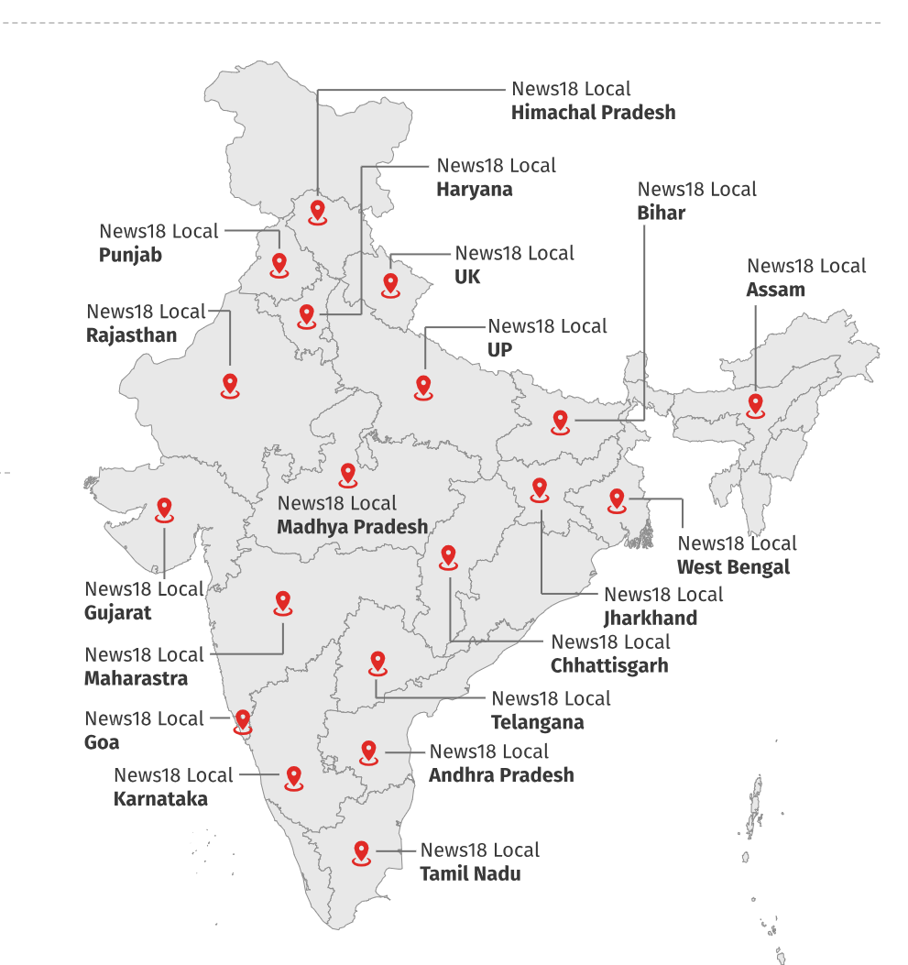
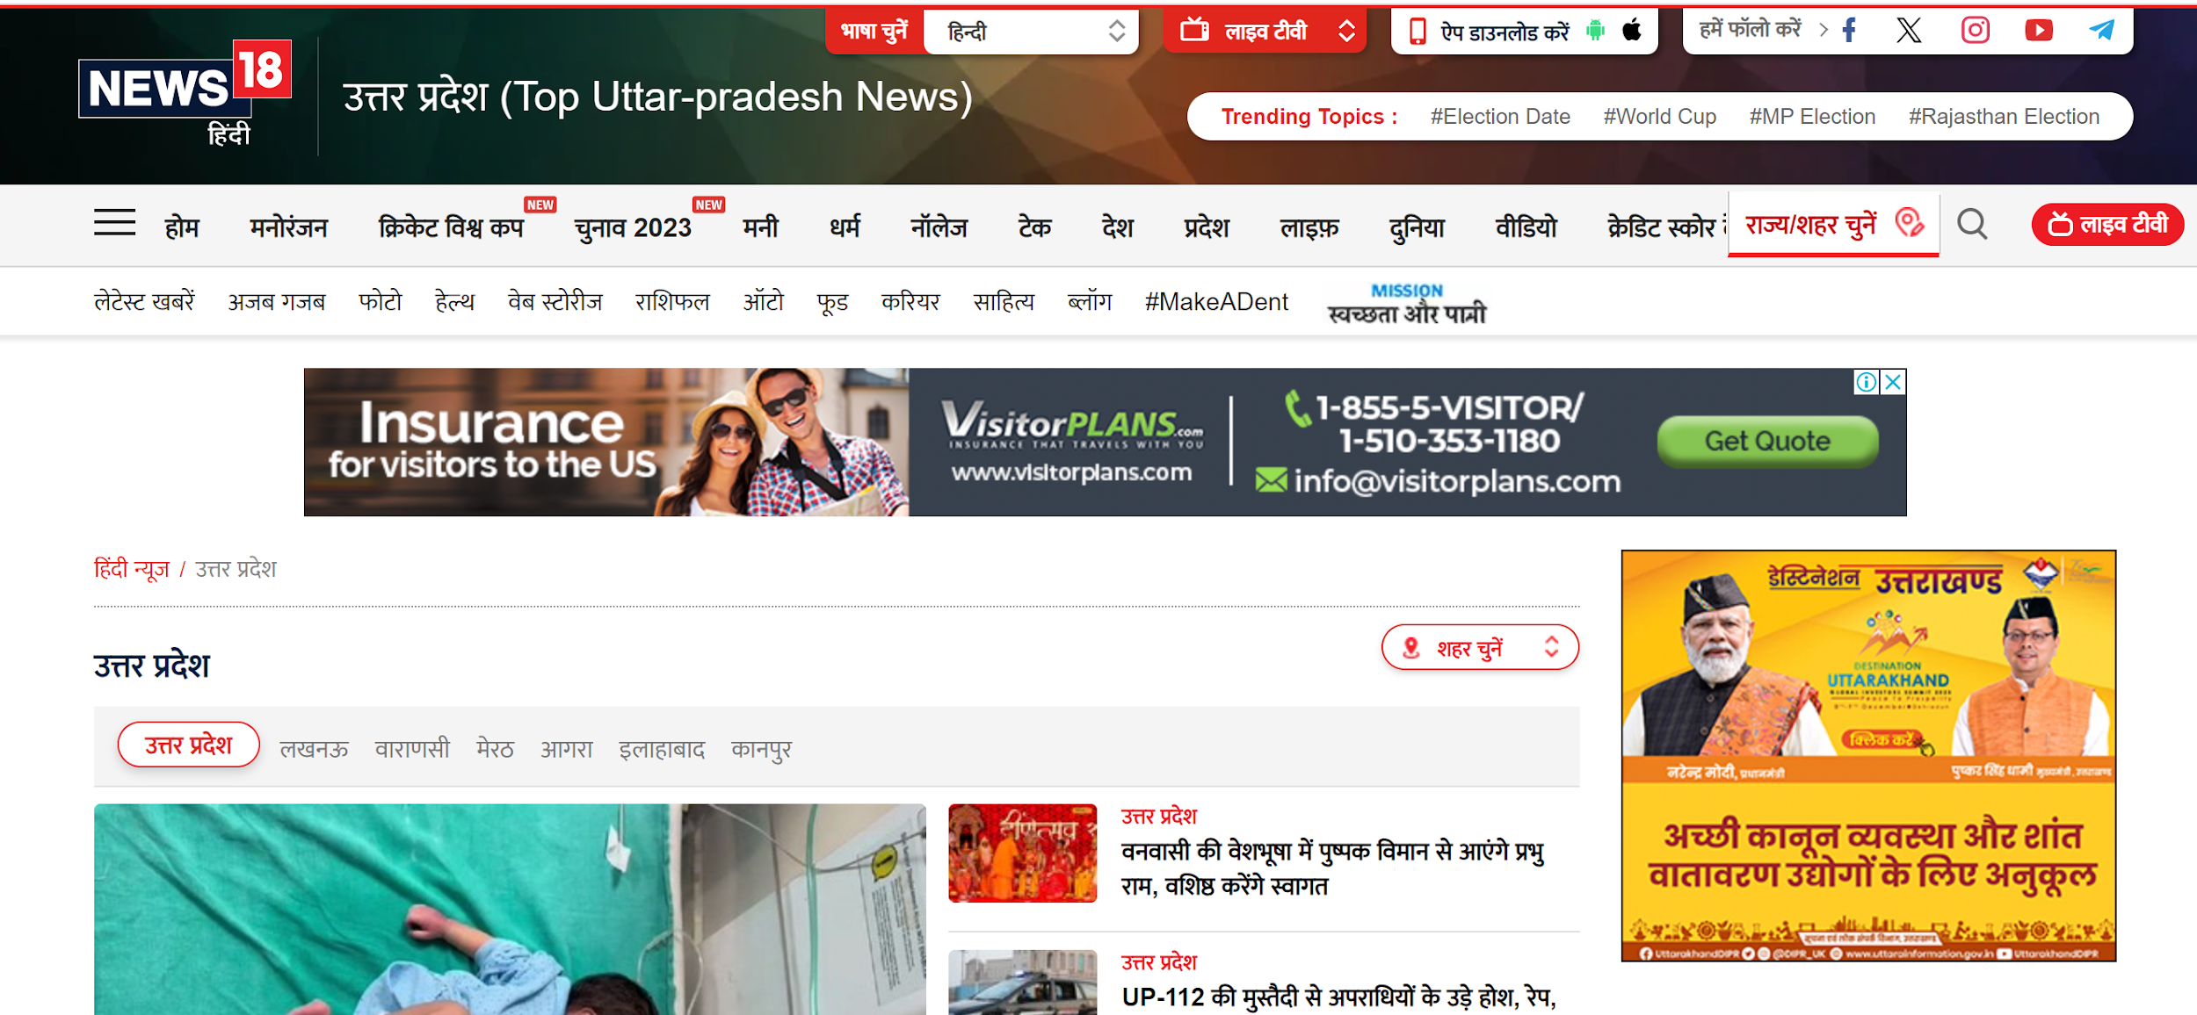
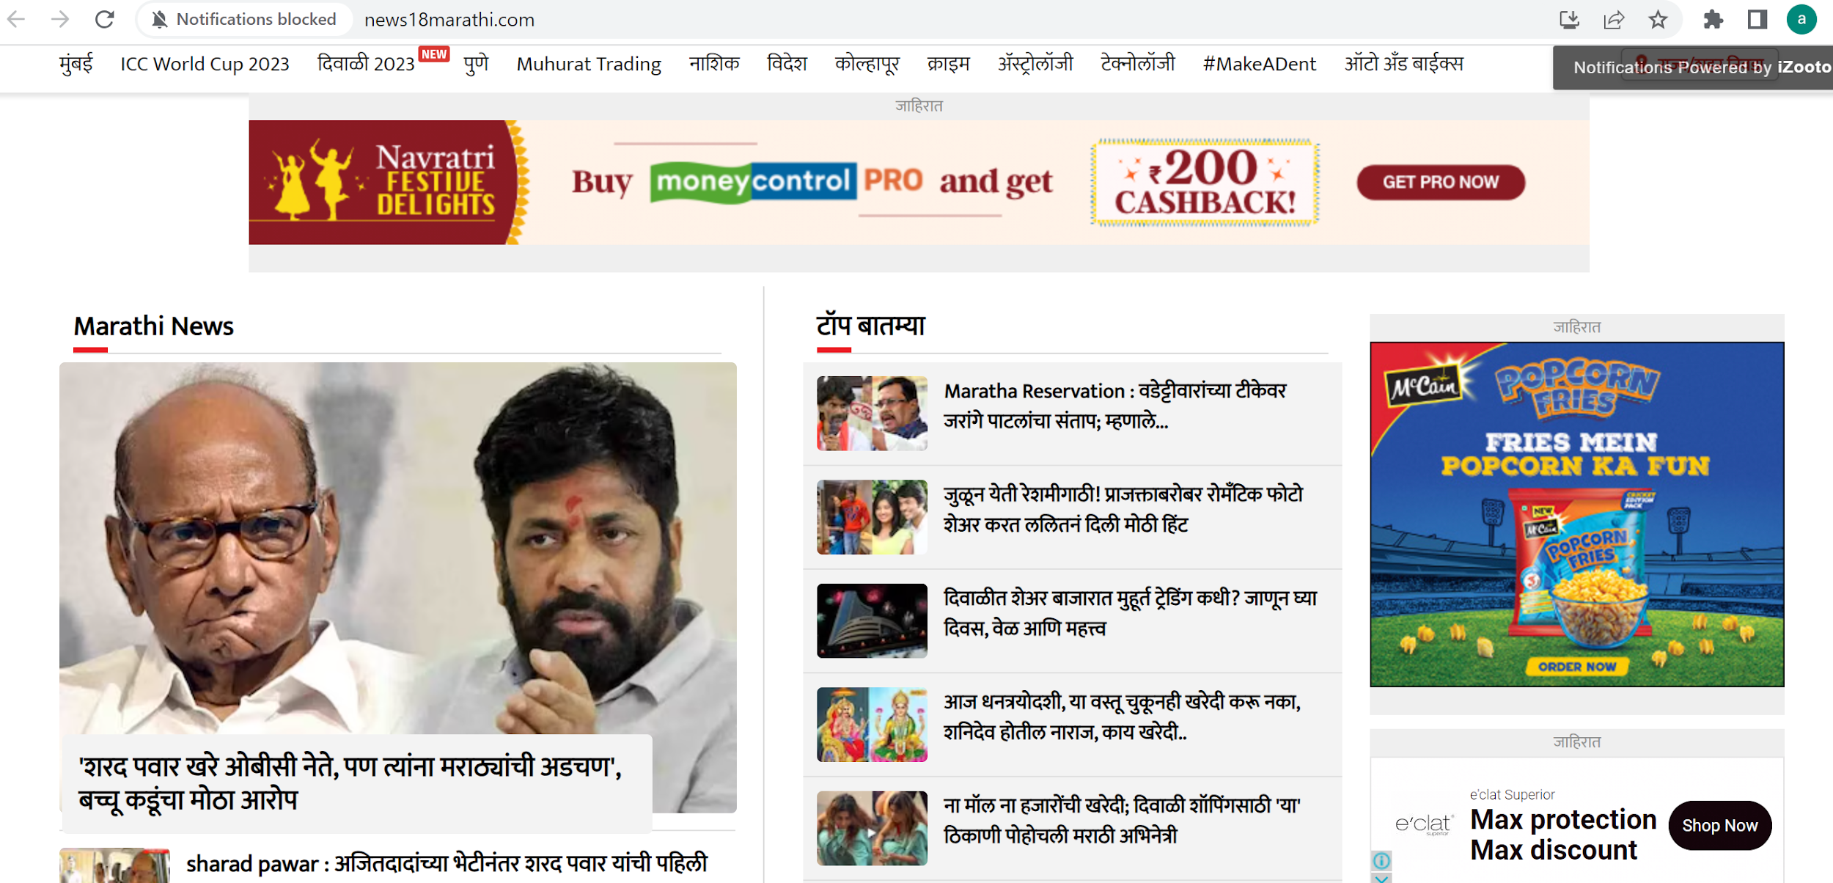
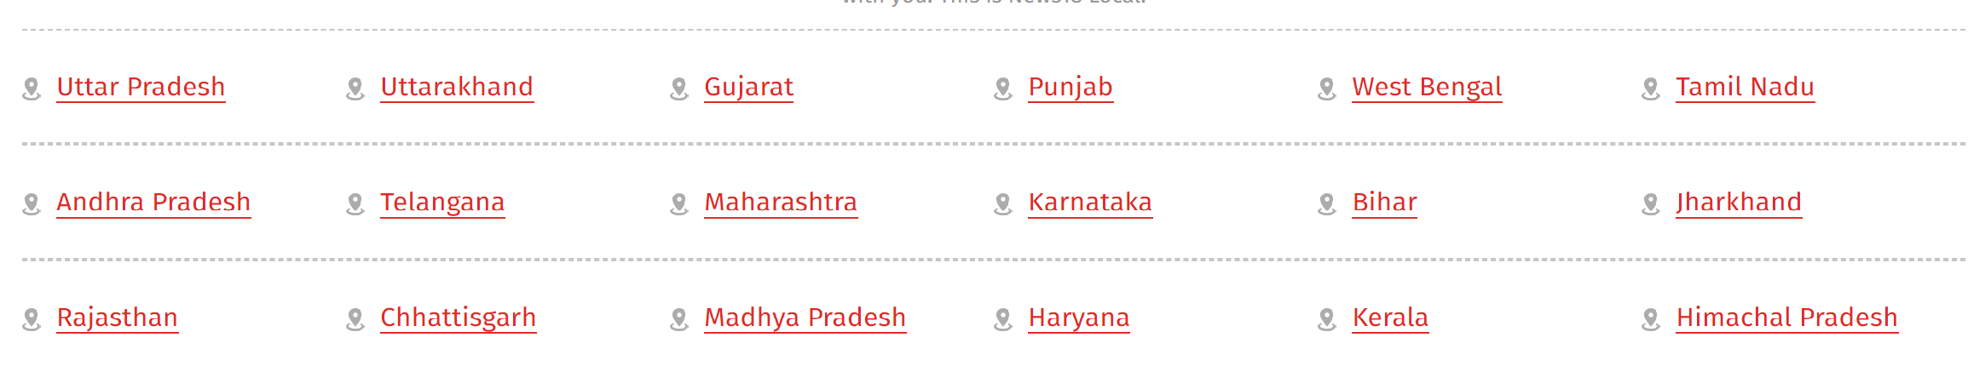

Slide 12
TV Campaign
Doctor Visibility on Television
What We Do:
• Feature doctors on national & regional TV
• Leverage health days for credible expert bytes
• Drive patient awareness through impactful storytelling
How We Help:
• End-to-end support: scripting, shooting, editing
• Broadcast-quality content across languages
• Position doctors as trusted, visible healthcare voices

Slide 13
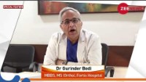
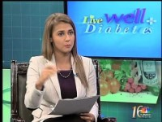
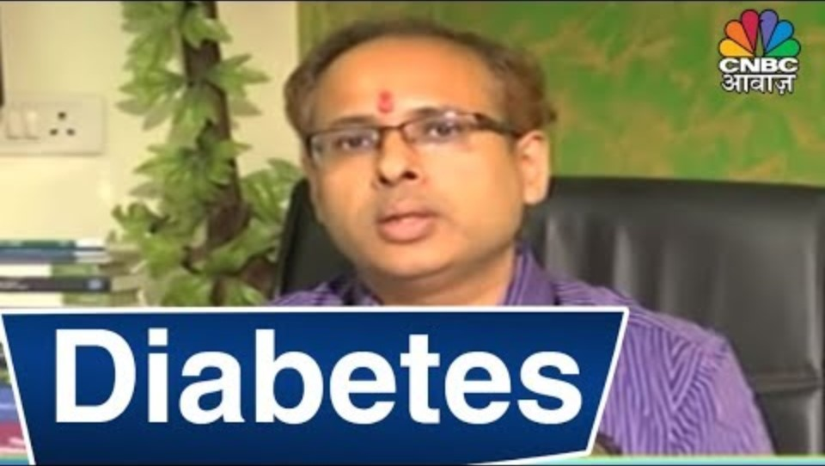
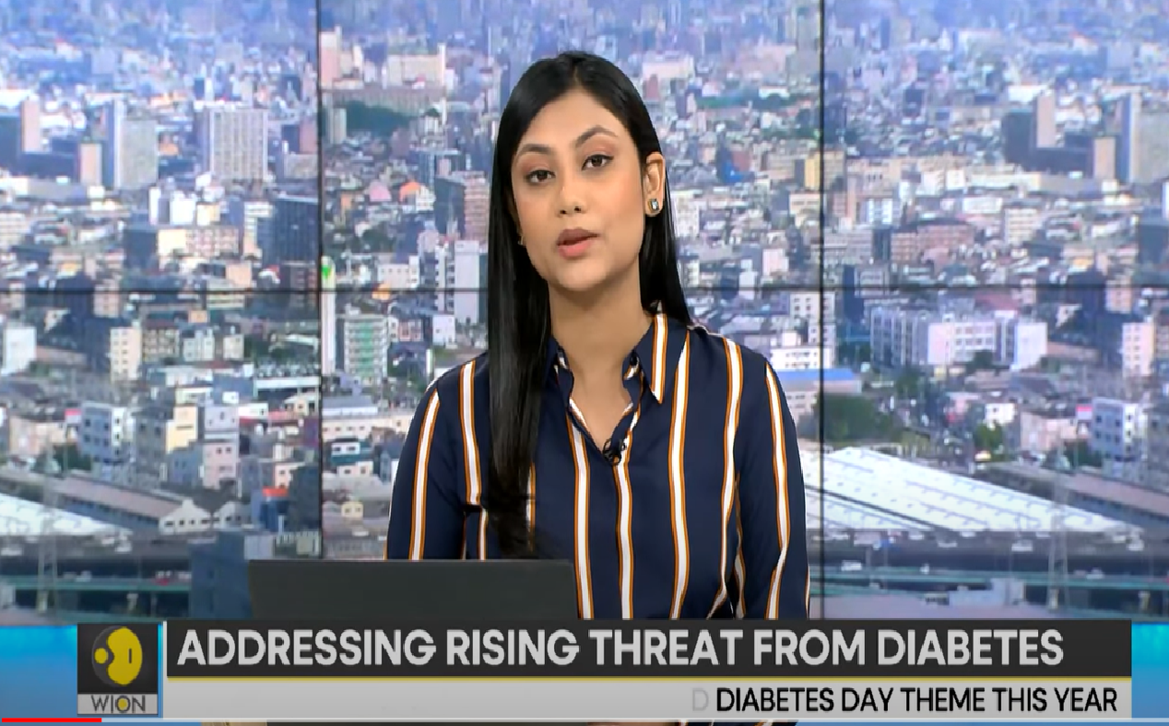
Formats TV
Short Health Byte
22 Min Panel
Discussion
22 Min Panel, shoot virtual
60 secs to 120 secs videos featuring doctors
A Large Number of Doctors can be effectively covered
Language bifurcation possible
Effective visibility when use across channels on health days
All Day Engagement
3 to 4 Doctors per discussion
Shoots Done in Studio setup
Promos announcing the program one week prior featuring the doctor
Brand can take ownership of the segment
Multi Language possible
30-minute prime time with lead anchor
Factoids
Aston Bands And L Bands
News feature integration
Visibility across the week
Effective to celebrate specific health days/weeks
Integrating Business heads from the company also is possible
4 Doctors per discussion
Shoots to be done on Zoom
Promos announcing the program one week prior featuring the doctor
Brand can take ownership of the segment
Multi Language possible

Slide 14
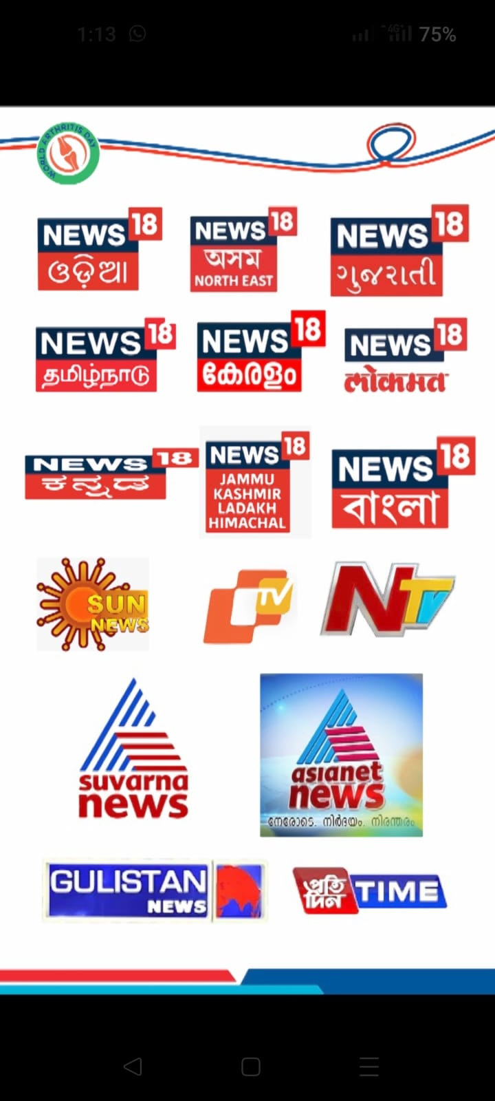
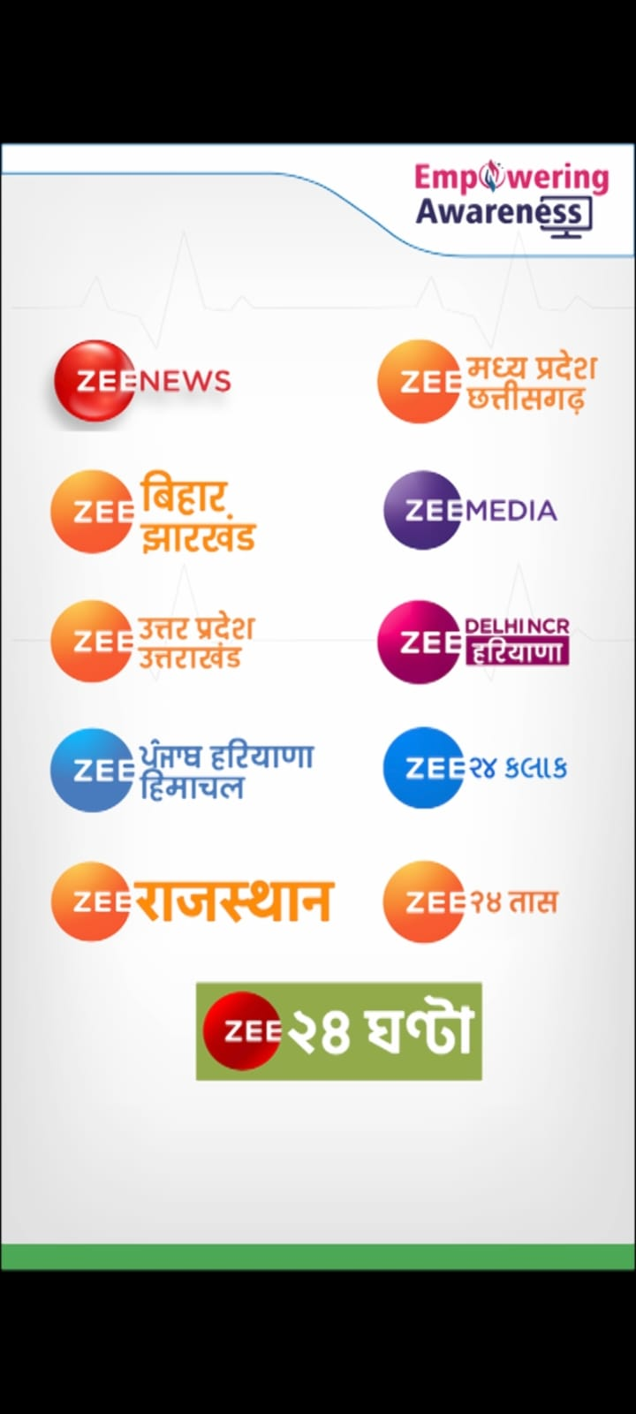
TV –ALL INDIA
ALL INDIA PRESENCE WITH REGIONAL CHANNELS
60 secs spots across 40 + channels panning all regions of India . Content will be regional and will have better connect

Slide 15
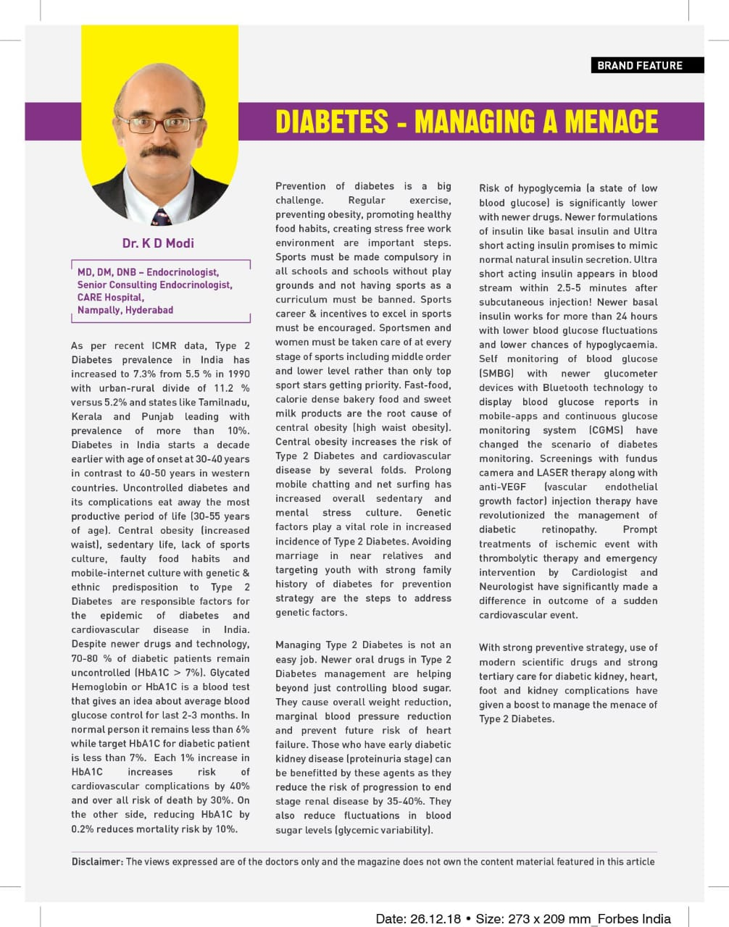
Print : Business Magazine
Outlook
Forbes India
Business World
Gruhashoba / Sarita , Women’s Era , Femina

Slide 16
Print
Doctor-Written Articles Publish articles authored by doctors in leading regional newspapers nationwide to establish authority and credibility. Focus on tips and insights for managing health effectively to lead a balanced and healthy life.
Dedicated Columns Collaborate with local newspapers and magazines to create an "Ask Your Doctor" column. This will invite readers to submit health-related questions, fostering community engagement and trust while promoting the campaign's core message.
Multilingual Content Ensure inclusivity and broad regional reach by making articles and columns available in multiple languages. Emphasize health management and lifestyle changes in culturally relevant ways.
Visual Appeal Enhance credibility and engagement by including a photo of the doctor with each article or column. Use vibrant visuals and quotes that reinforce the campaign theme, such as "Healthy Living for All.“
Thematic Alignment Align all content with the overarching campaign theme to maintain consistency and inspire individuals to take proactive steps toward better health and well-being.

Slide 17
Radio Campaign Expertise
Multilingual doctor voice bytes on top FM stations
RJ-led talk segments embedding medical insights
Branded weekly capsules & patient story series
Digital extensions: Spotify, JioSaavn, WhatsApp
Post Telecast extensions on social media , physical poster and WhatsApp embedded mpeg video posters
Radio Mirchi (98.3 FM) Red FM (93.5 FM) Radio City (91.1 FM)
Big FM (92.7 FM) My FM (94.3 FM) Fever FM (104 FM) Vividh Bharati / AIR FM

Slide 18
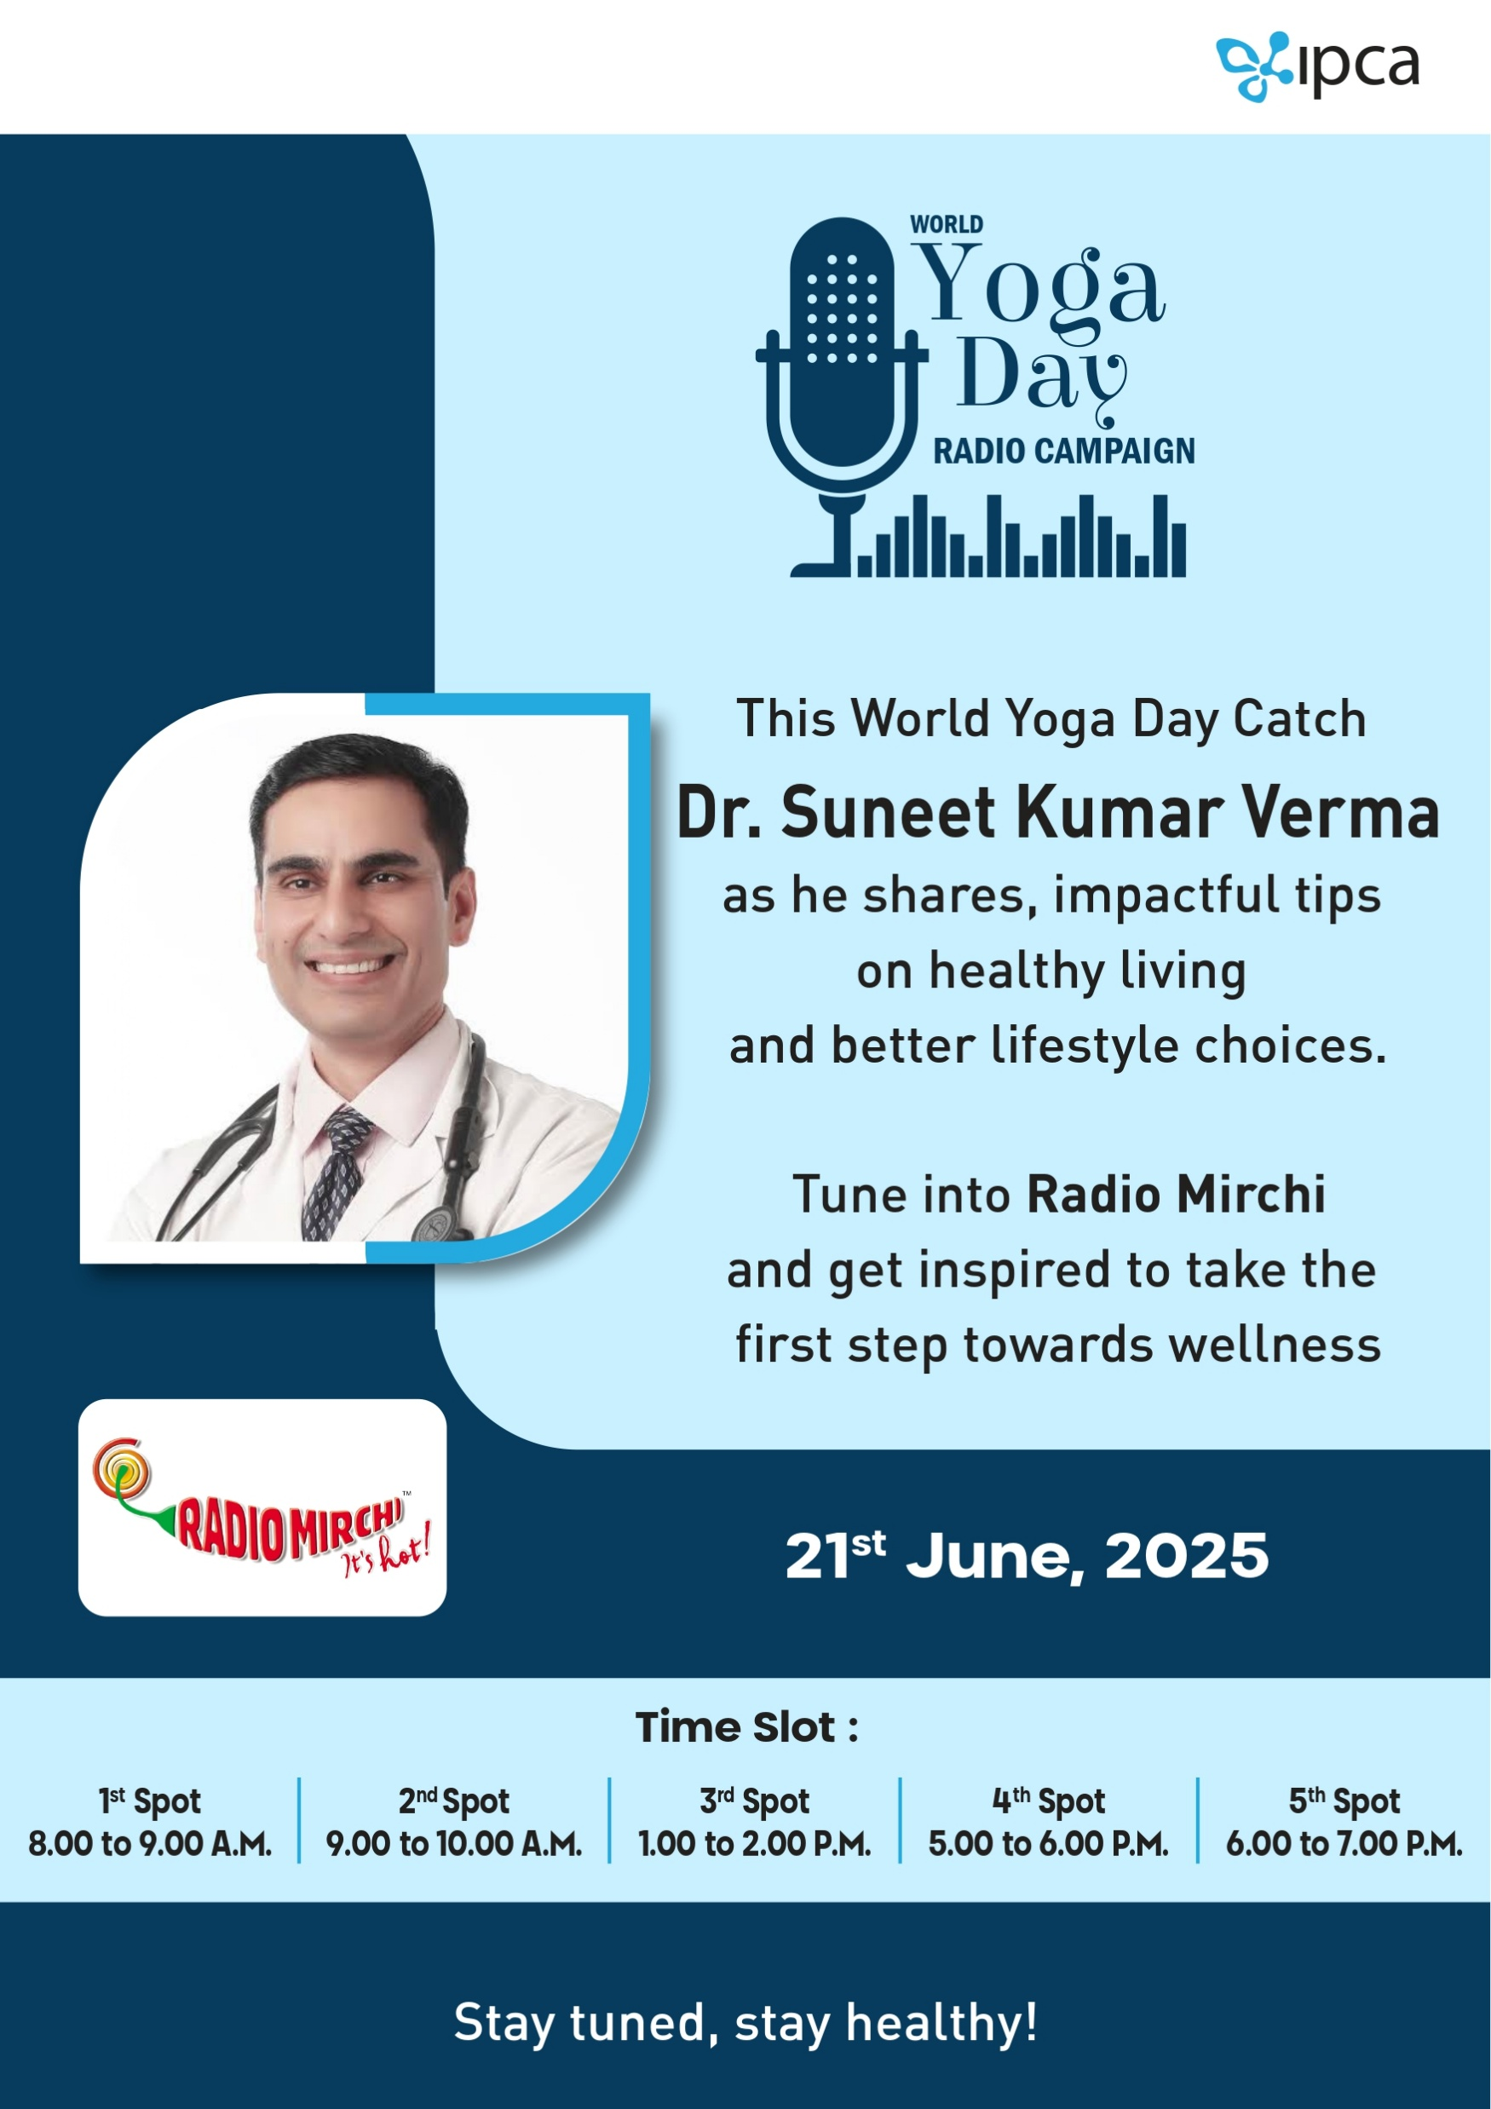
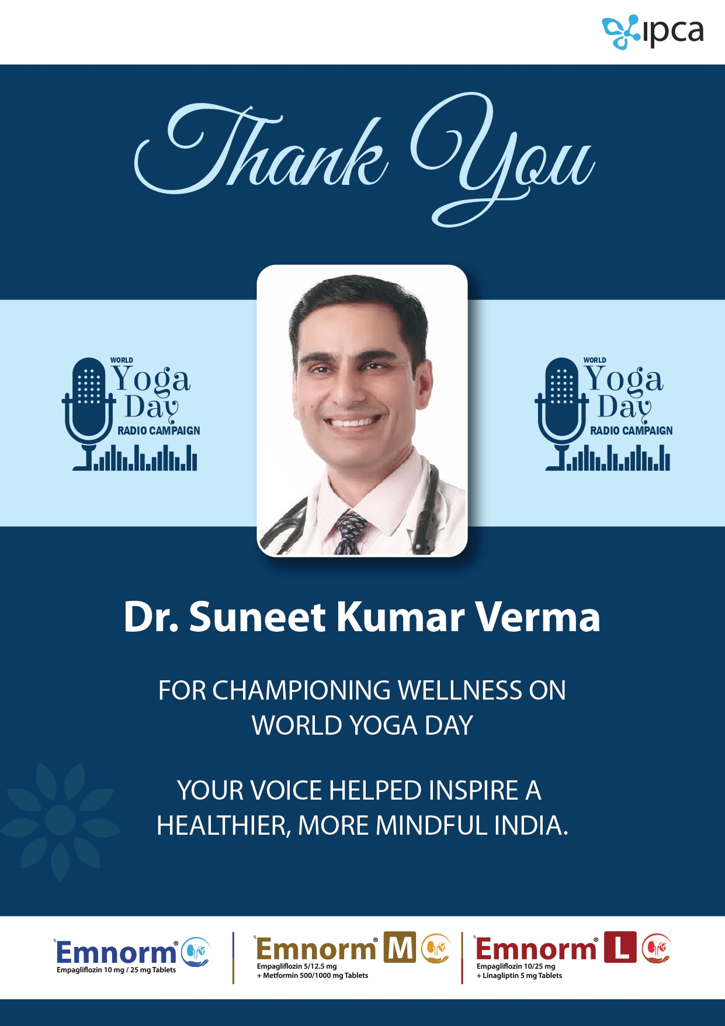
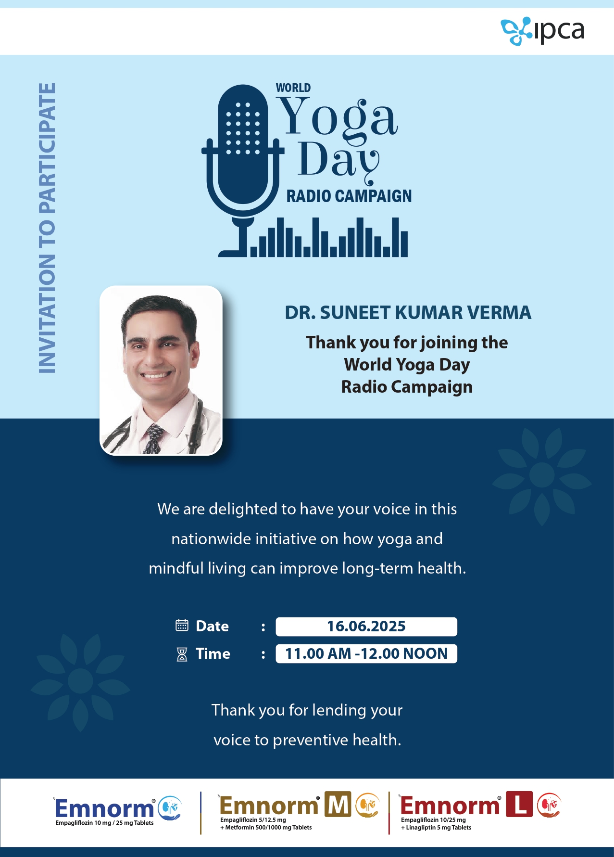
TOUCH POINTS
INVITE
TIME SLOT
THANK YOU CARDS

Slide 19
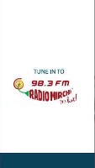
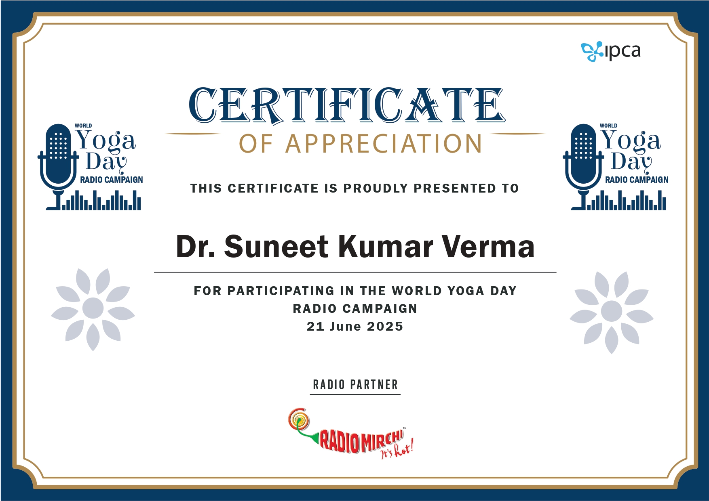
Digital Touch Points
REELS
CERTIFICATE

Slide 20
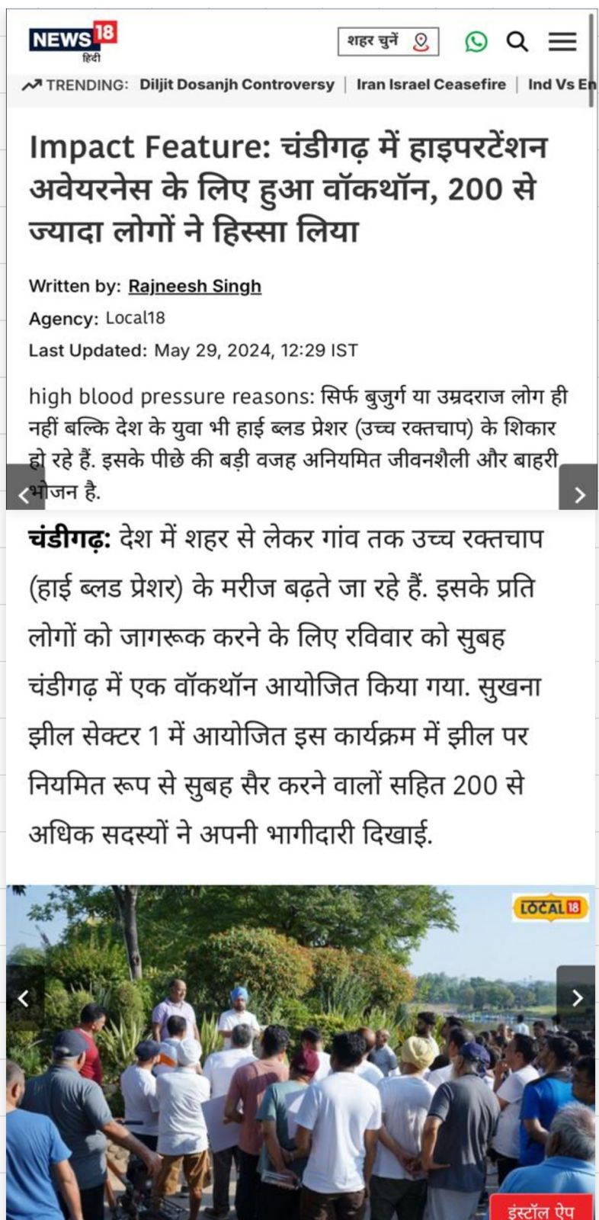
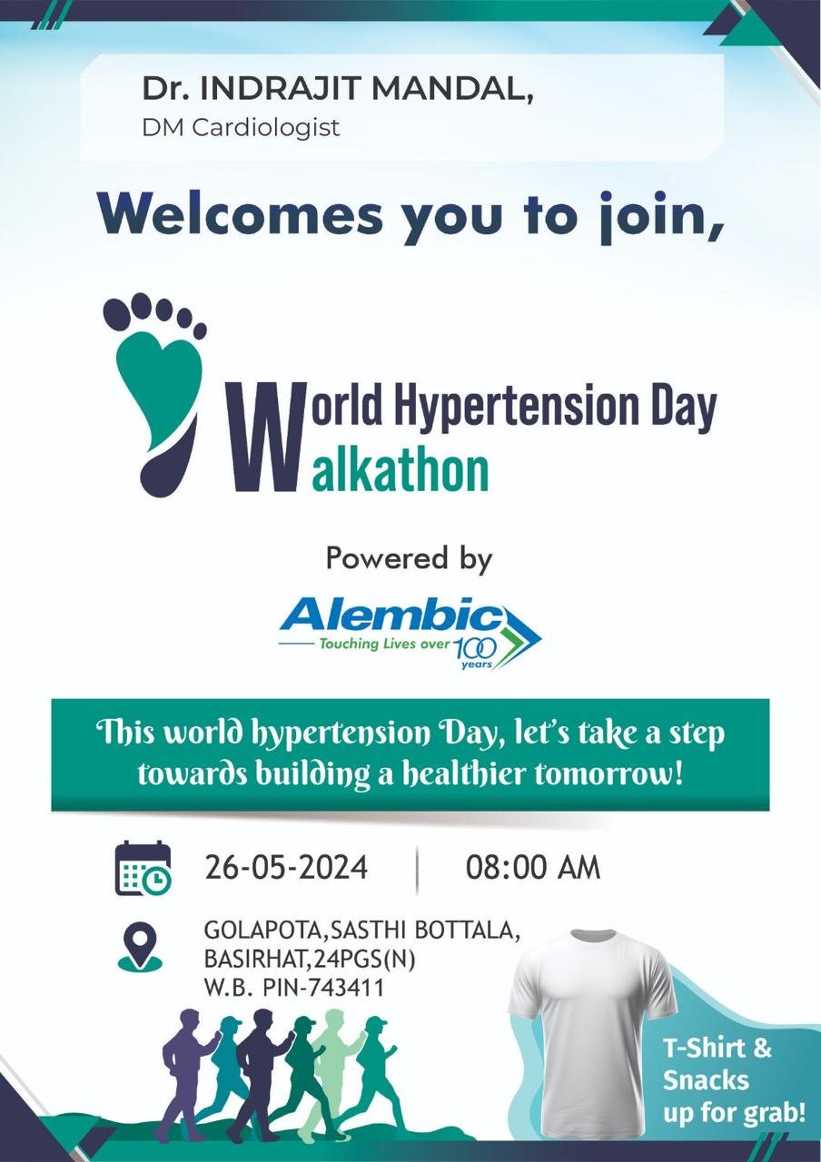
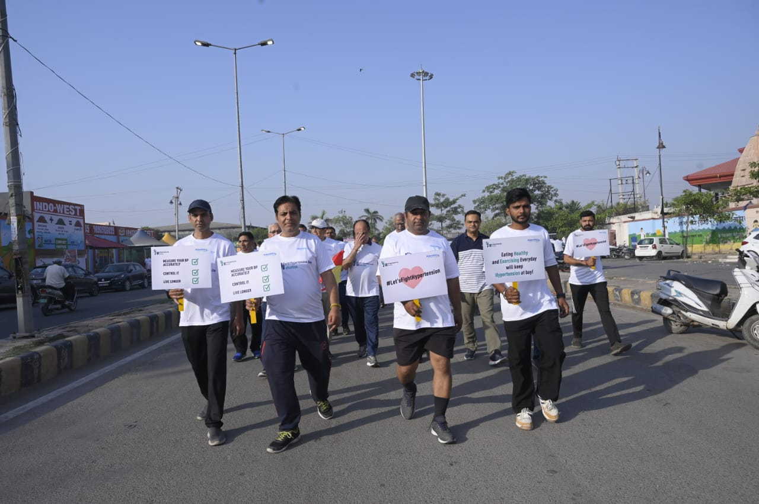
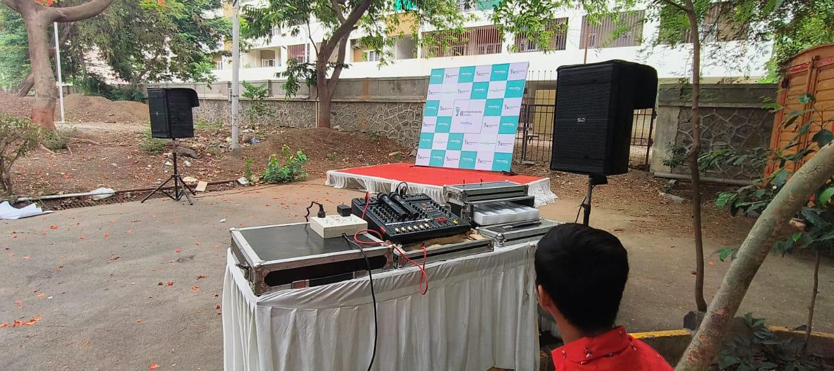
On Ground Activity
Walkathons / Cyclethons / Marathons
CPR training
Yoga Day activations
Corporate Activations
Guinness Book and Asia and India Book of World Records

Slide 21
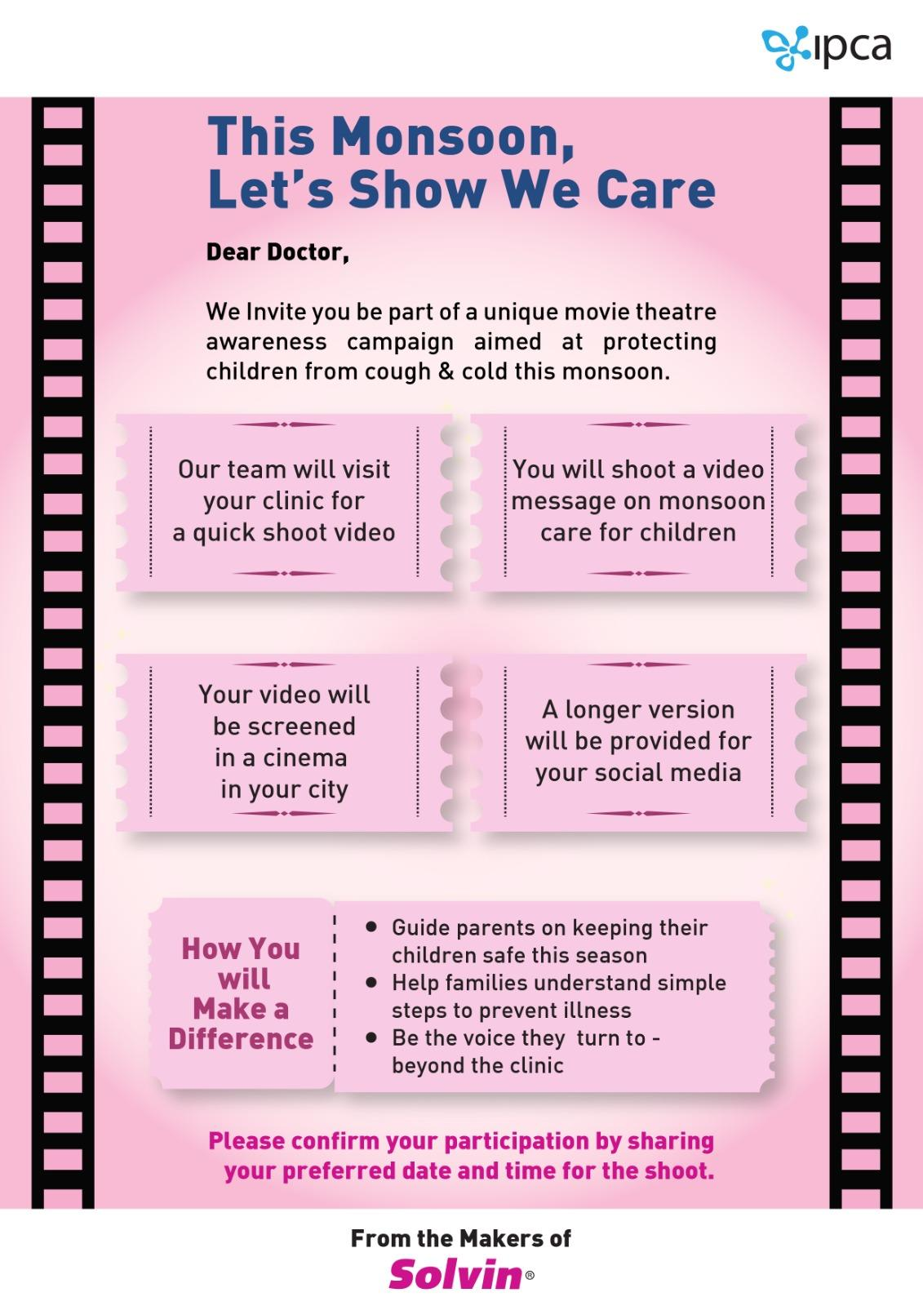
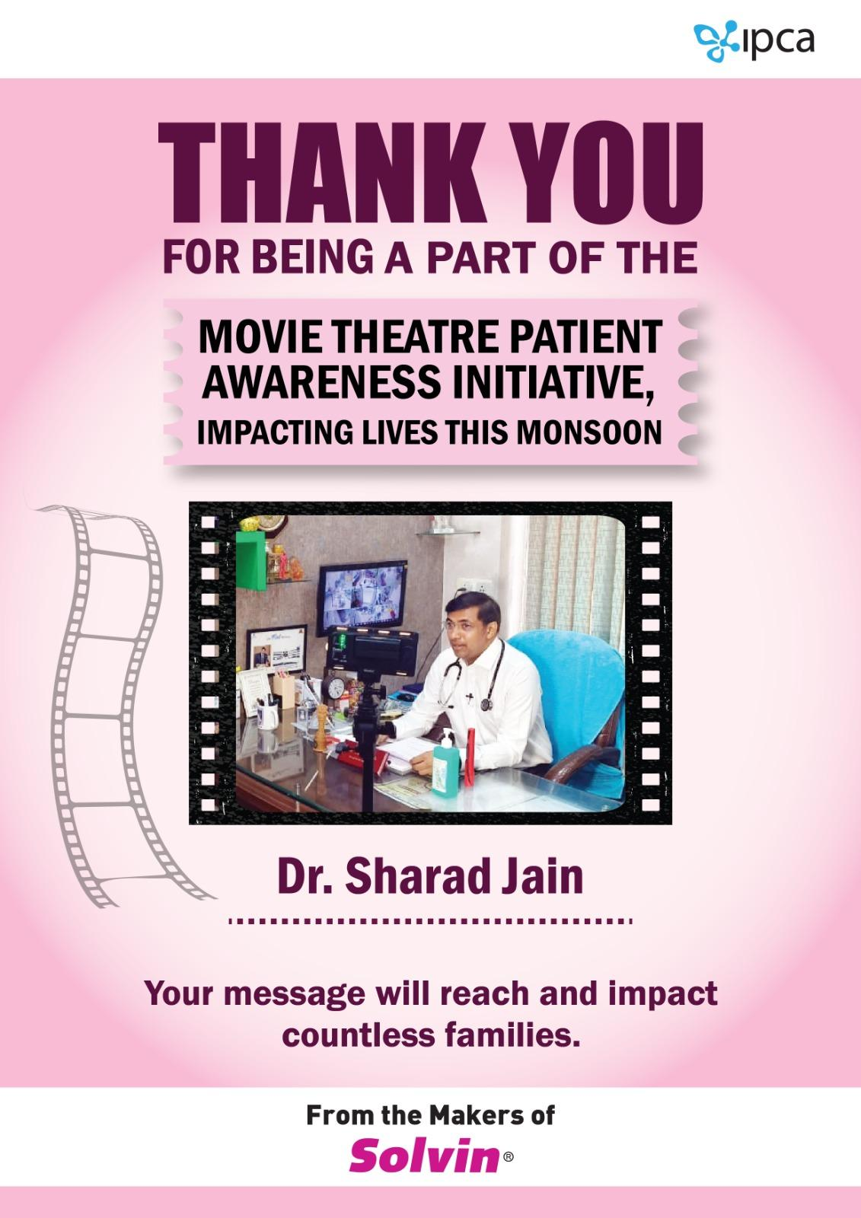
Cinema theatre Activations
Objective: Engage a captive, high-footfall audience with branded health awareness content in premium cinema environments.
Activation Elements:
Branded AV (60 sec): Played before feature films
Doctor Video Bytes: Region-specific messages played as awareness clips
Standees & Posters: Placed in cinema lobbies for visual engagement
QR Codes: Scan-to-watch full video library or
Target Locations: Top PVR, INOX, Cinepolis screens in metro & Tier 1 cities (customizable)

Slide 22
Social Media
Social Media Engagement Plan
Platforms: Instagram, Facebook, Twitter, YouTube
Key Activities:
Social media strategy and planning
Platform management and content creation
Creative designs and detailed reporting
Video Content Development
Raw videos recorded will be professionally edited.
Design integration:
Addition of opening and closing sequences.
Supers with essential details to enhance visuals.

Slide 23
Social Media
Thematic Video Rollout
Videos featuring doctors will be released thematically throughout the year.
A comprehensive content library will be built on the webpage.
Targeted Marketing
Focused radius targeting within 10 km for improved visibility and outreach.

Slide 24
Geographically Managed Reach
Localized Social Media Ads
Deploy geo-targeted ads on platforms like Facebook, Instagram, and Google to reach audiences within a specific radius (e.g., 5 km) around the clinic.
Highlight the doctor’s articles, health tips, or awareness content with clear calls-to-action, such as booking consultations or attending health events.
Google My Business (GMB) Optimization
Optimize the clinic’s GMB profile with expert health advice, FAQs, and tips tailored to common health concerns like diabetes.
Share regular updates with localized hashtags and keywords to boost visibility in local searches.
Interactive Campaigns
Host live Q&A sessions or webinars featuring the doctor on platforms like Facebook or YouTube, inviting local residents to participate.
Promote these events with geo-targeted ads and localized invites to maximize community engagement.

Slide 25
Geographically Managed Reach
4 Collaborative Engagement
Partner with local influencers or community groups to amplify the doctor’s content and encourage participation in health initiatives.
Co-create content with local organizations to further establish trust and relevance within the community.
5 Localized Content Series
Develop a series with doctor-led content focused on preventive healthcare and tailored to the local community’s needs.
Share the series across social media, newsletters, and local media outlets for maximum reach.

Slide 26
Podcast channel
Create a Dedicated Podcast Channel: Launch a specialized channel focusing on targeted health concern .
Host interviews featuring doctors sharing expert insights, guided by an anchor.
Content Highlights
Episodes uploaded regularly: weekly, daily, or every 3 days with a new doctor.
Include the doctor's name, credentials, and additional details for credibility.
Multilingual Reach
Episodes available in multiple languages to connect with a diverse audience.
Enhanced Visibility
Leverage cross-promotions to maximize audience reach.

Slide 27
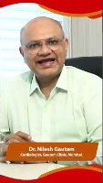
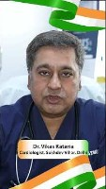
Festive Engagement
Festive Engagement with " Thematic.
Short, personalized videos of doctors sharing festive wishes with health tips.
Combine celebration with valuable advice for patients.
Examples o Festive Greetings: "Diwali: "Celebrate Diwali with healthy choices. Keep your heart shining bright like the diyas!"and embrace the sweetness of a balanced life!" Independence Day
Builds trust and strengthens doctor-patient engagement.
Delivers actionable health advice in a relatable and celebratory manner.
Encourages positive health choices during festive seasons.

Slide 28
Customised Video Engagements
Doctor-Led Patient Education:
Webinars and Workshops: Interactive, doctor-led sessions to educate patients on lifestyle management, nutrition, and mental well-being.in corporates
Customized Video Messages: Featuring doctors delivering personalized tips, reinforcing their role as trusted advisors.

Slide 29
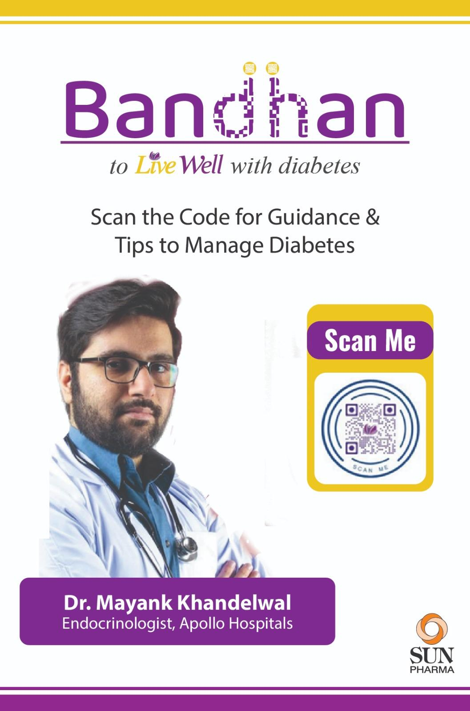
Customised Video Engagements
Localized Messaging
Doctors deliver messages in regional languages to connect with local audiences.
Distribution Channels:
Distribution Strategy
📱 Social Media & WhatsApp Groups
📄 QR Codes on Printed Materials
🌐 Microsite: Video Library
Personalized Video Tips
Short, engaging videos featuring doctors sharing practical advice:
3 Morning Habits to Start Your Day Right with Diabetes
How to Read Food Labels for Hidden Sugars
Simple Exercises to Keep Your Sugar Levels Stable

Slide 30
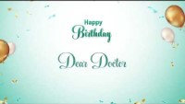
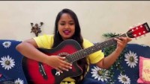
Personalised musical greetings for Doctors
To create customised greeting featuring a singer who will wish the Doctor on his birthday with a song or a fun musical mashup .
This can be further customised with messages from family and friends.

Slide 31
Case Study Preview
The following slides showcase how we successfully collaborated with a client to engage 850 doctors across India through a structured 12-month communication plan.
An integrated campaign built on consistency, credibility, and creative execution where each doctor was touched multiple times through the course of the year

Slide 32
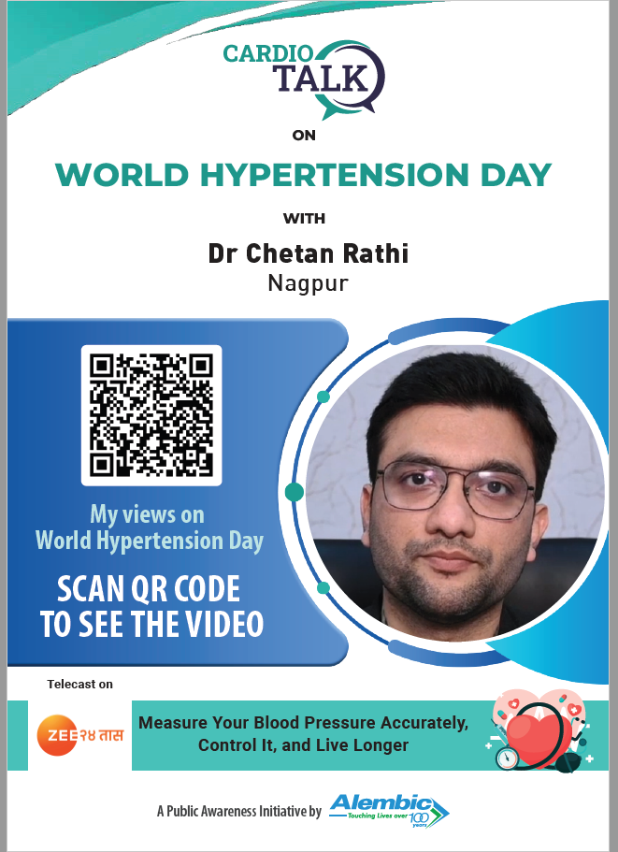
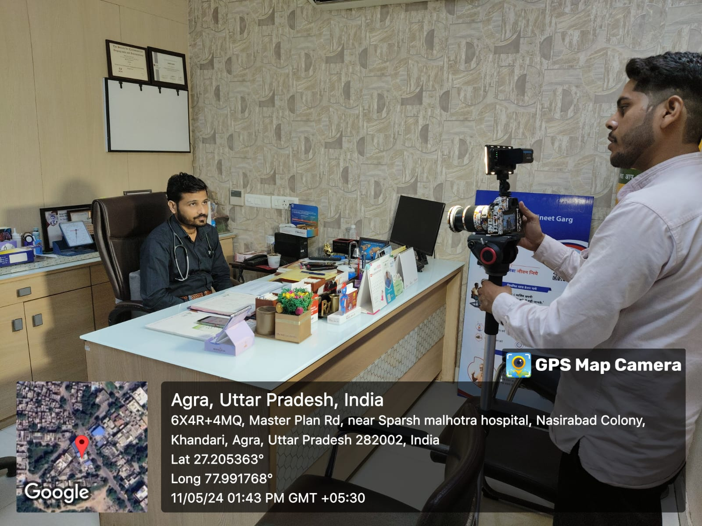
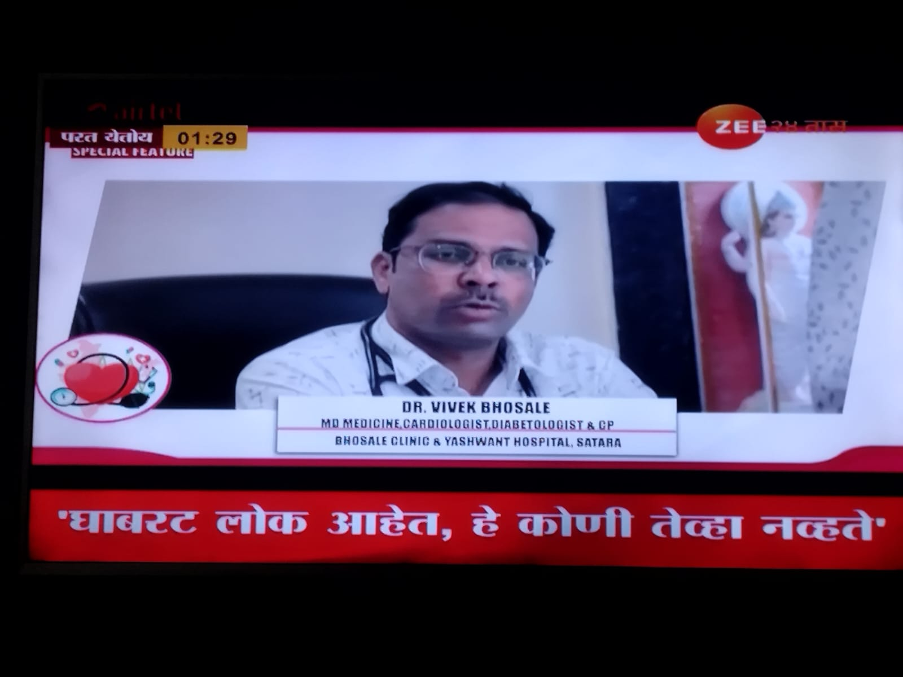
A Suggestive Monthly Media Touch Point Plan
April
May
June
Send invites to Doctors inviting them to the campaign .
Physical shoot Shoots begin
Touch point 1 : Invite and enrolling Touch point 2: Appoinment for shoot
World Hypertension Day 1 min segment on top national news channels featuring the idea Touch Point :3 Get approvals from doctors Touch point 4 : share details of telecast Touch point 5 : Showcase telecast
Distribute Posters with doctor byte inserted as QR codes . These physical posters will be uploaded online and the Managers can print them and distribute it to the doctors Touch Point 6

Slide 33
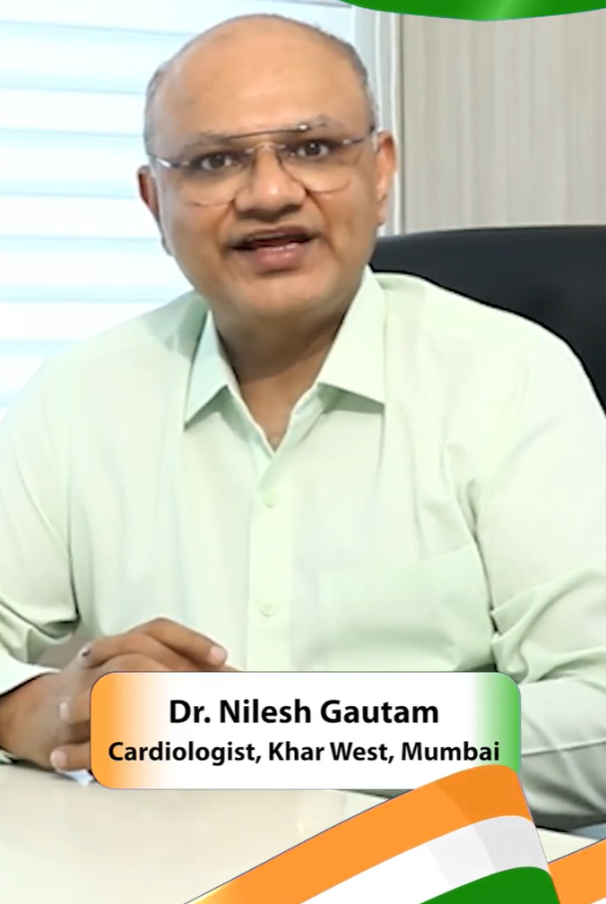
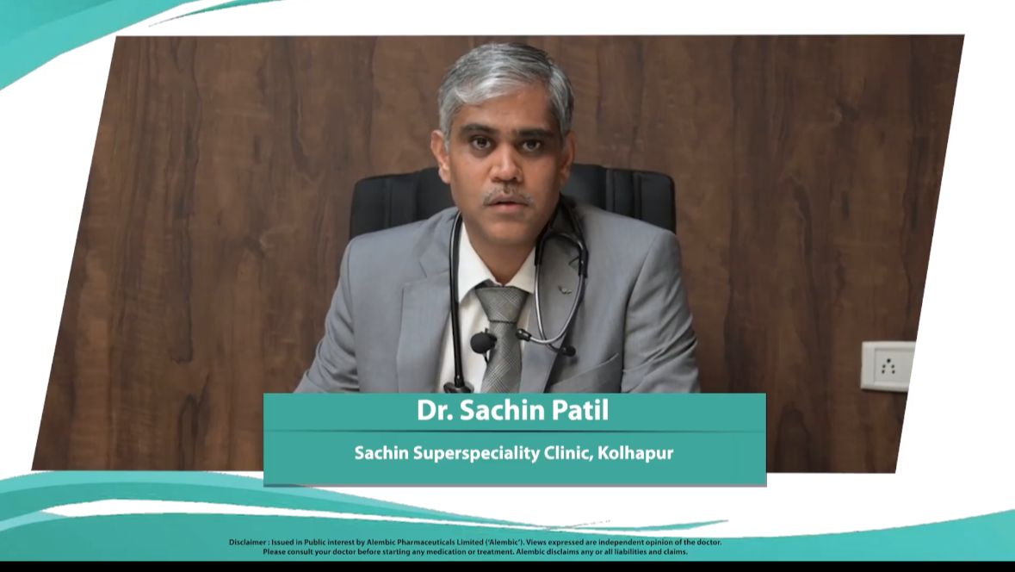
Monthly Media Touch Point Plan
July
August
September
Heart Day On TV
Digital Campaign of Doctors on Local 18 .com .
2 .5 minute videos of doctors on Local 18 websites and a blog accompanying it .
Happy, healthy, and sweet Independence Day.!"A video wish campaign which we will create with doctor video wishing people with tips . The doctor can further share this with his patients and on his Social media handles
https://drive.google.com/drive/folders/1AuAH7pztUKN56C05kCOMiCVkEQJKxof5
On Ground walkathon

Slide 34
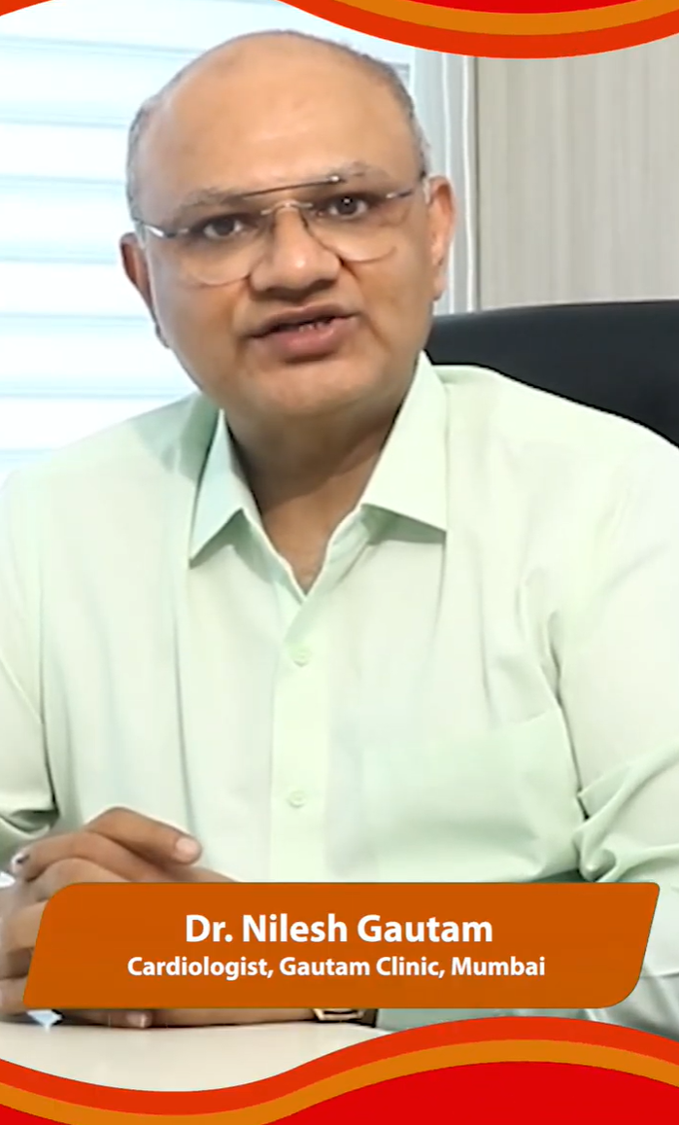
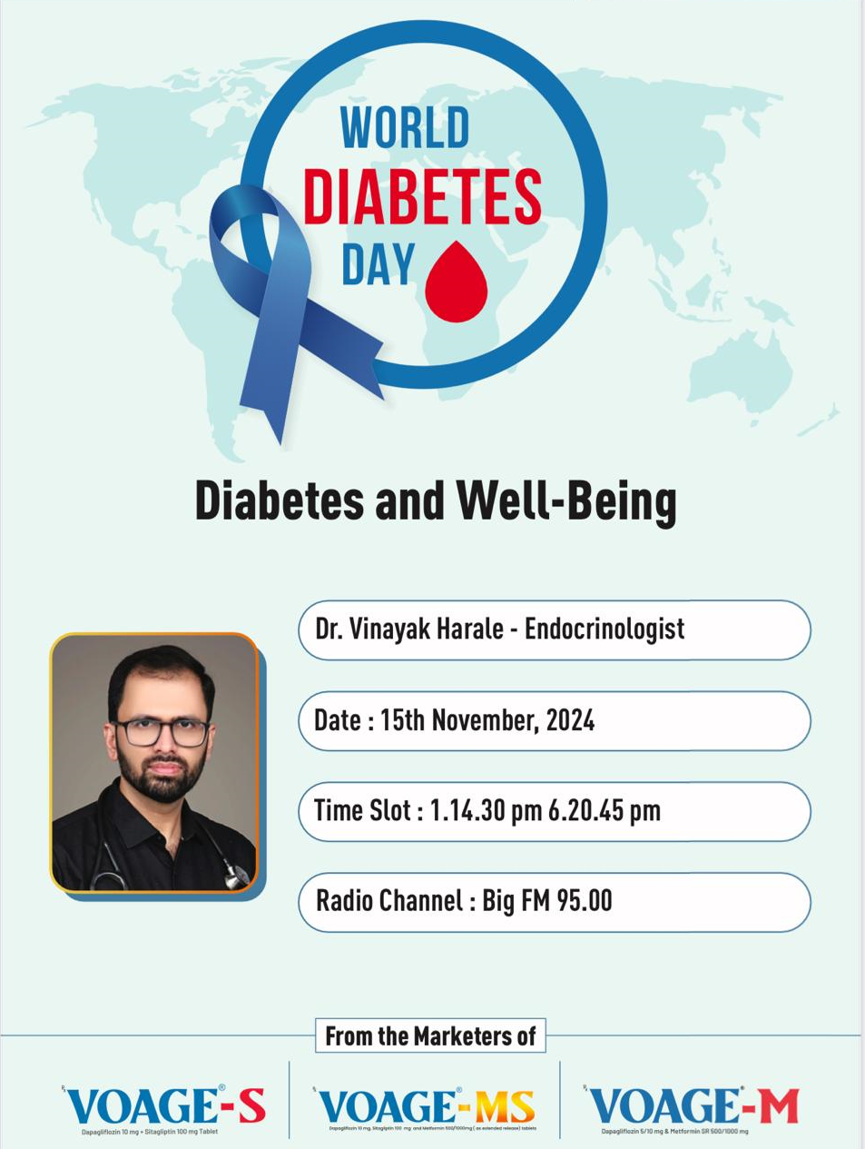
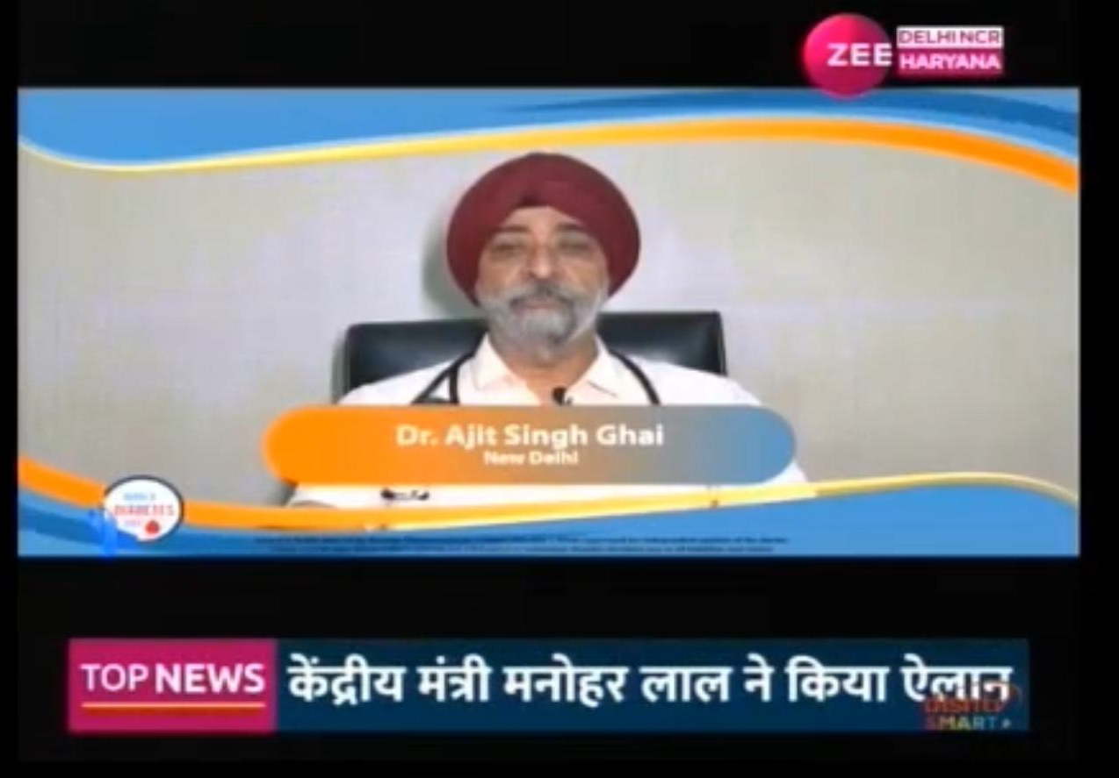
Monthly Media Touch Point Plan
October
December - January
November
Distribute Posters with doctor byte inserted as QR codes . These physical posters will be uploaded online and the Managers can print them and distribute it to the doctors
.
May the light of Diwali bring you and your family good health, peace, and prosperity.! Happy Diwali!"
World Diabetes Day Tv Campaign Furthering the message
https://drive.google.com/file/d/187LHgUE5IDxj_YAbSk9rEtf_BDhr8xhz/view

Slide 35
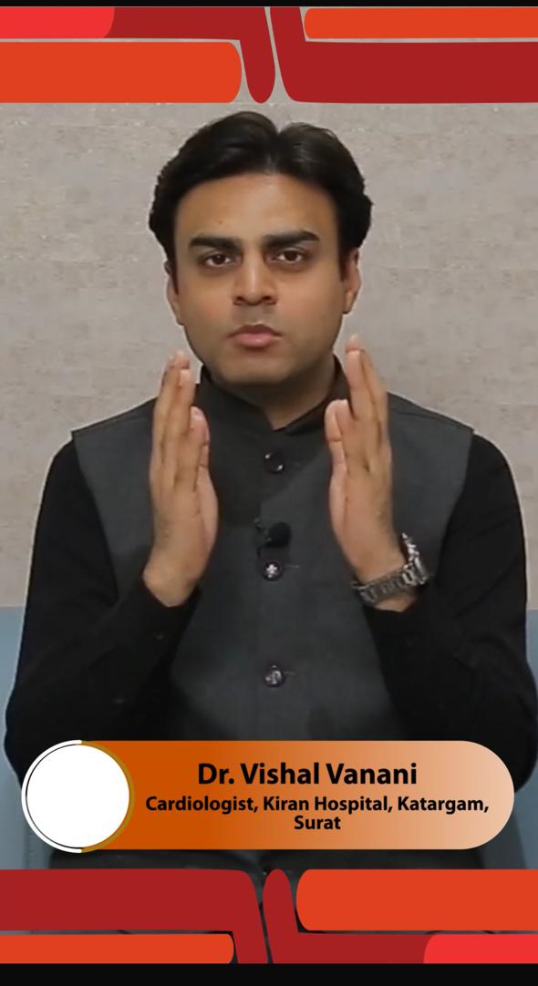
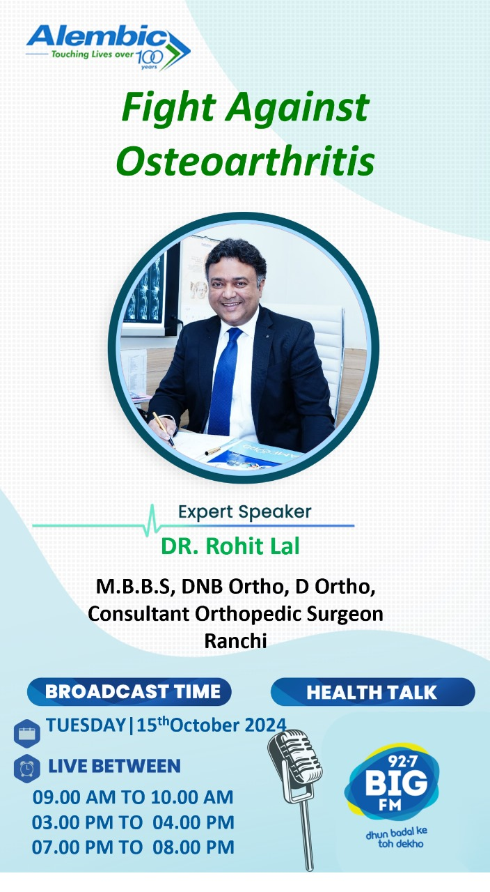

Monthly Media Touch Point Plan
January
February
March
New Year Wishes by the Doctor to his patients . Pledge to Live well this new year Choose health, choose happiness!
Doctors on Radio Across India RJ Interviews with Doctors on the thematic well with Diabetes
Celebrate the Success Acknowledging the Doctors the Ambassadors

Slide 36


Monthly Media Touch Point Plan
Year Long Social media campaign featuring doctors covering various dynamics like Health , Diet Exercise , women topic prevalent to the month will be covered . We will have 4 Doctor Videos , blogs and interviews populated on You tube , Face book and a Website created and maintained for Liv Well With Diabetes

Slide 37
The Process
Data Collection and Content Creation Process
Doctor Selection and Scheduling Finalize the list of participating doctors and schedule individual sessions.
Content Capture Conduct on-site video shoots with each doctor on diverse topics, using a dedicated camera crew.
Data Packaging Process and package the collected footage into multiple formats for distribution, as outlined in the following slides.

Slide 38
“Spreading awareness, driving change, and delivering measurable impact.”

Slide 39
THANK YOU
Anusha@flcmediasolutions.com/ Tel No : 9820432504

